Slide 1
Affordable Housing Project
Final Capstone Project
Sangeetha Chinnan

Slide 2
Housing in San Francisco Bay Area
Nine Counties in Bay Area
Alameda, Contra Costa, Marin, Napa, San Mateo, Santa Clara, Solano, Sonoma, and San Francisco
Most expensive place to live in the United States
Study helps to find an optimal location for affordable housing project with close proximity to the restaurants or venues

Slide 3
Data Acquisition and Cleaning
County boundaries extracted from Open Data Soft website.
List of counties in California and the subset of those counties in Bay Area from DataSF(Office of chief Data Officer).
The dataset for the Average housing price are extracted from Zillow.
Venue details extracted from Foursquare API.
Cleaned data contains the data for nine counties in Bay Area.

Slide 4
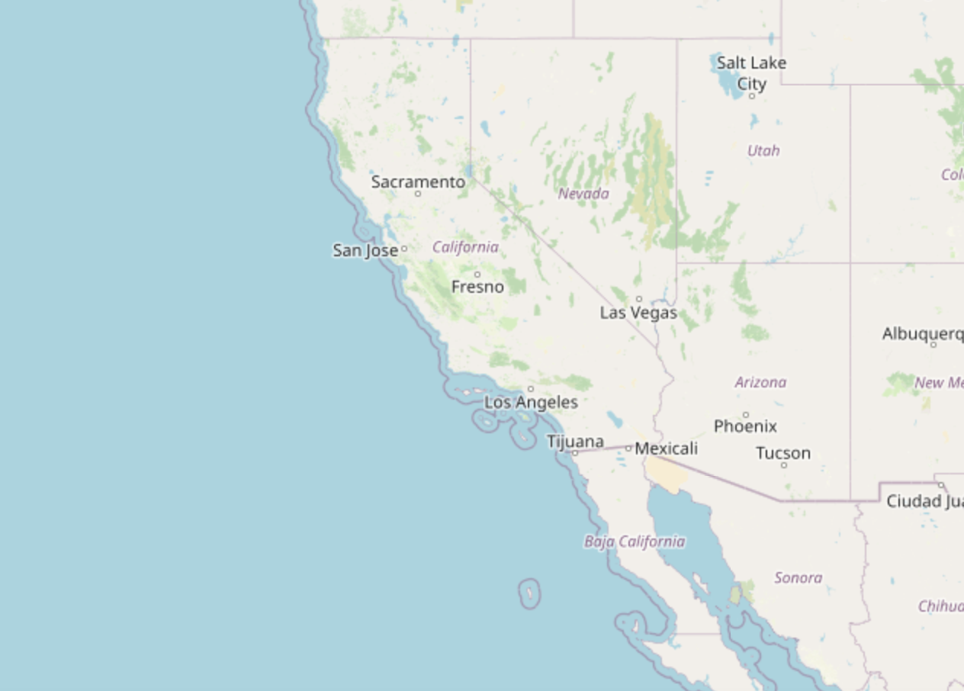
Folium Map for Visualising California

Slide 5
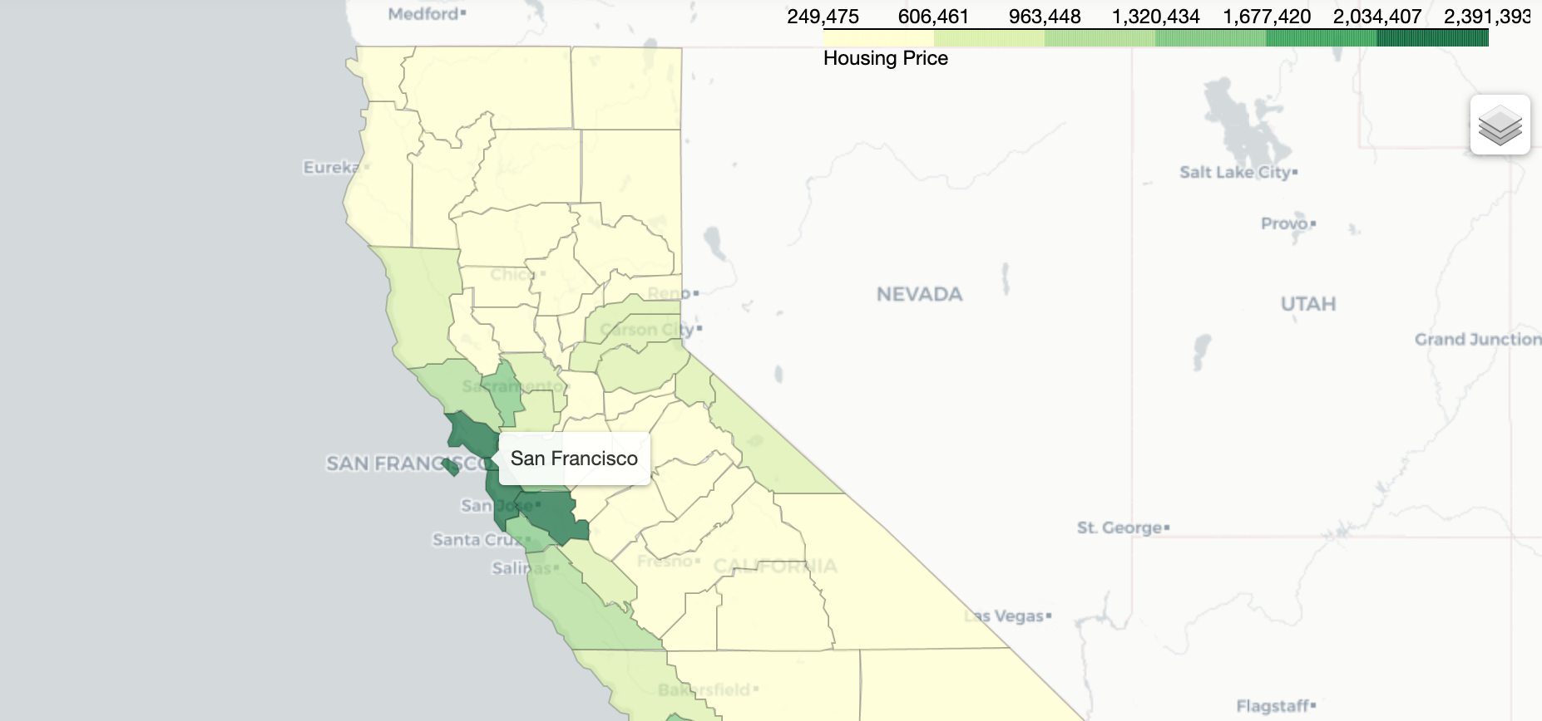
Choropleth Map for Average Housing Price

Slide 6
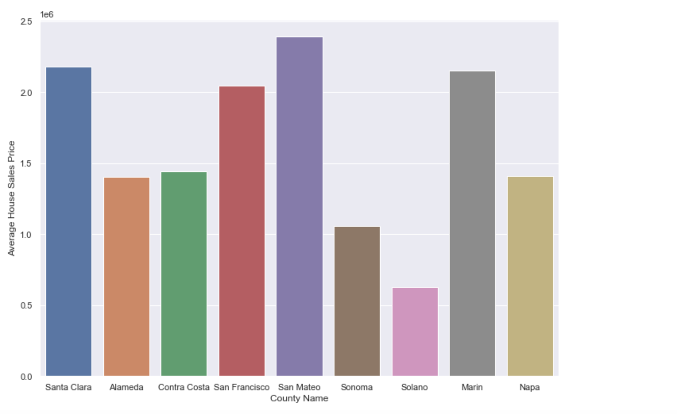
Bar Plot

Slide 7
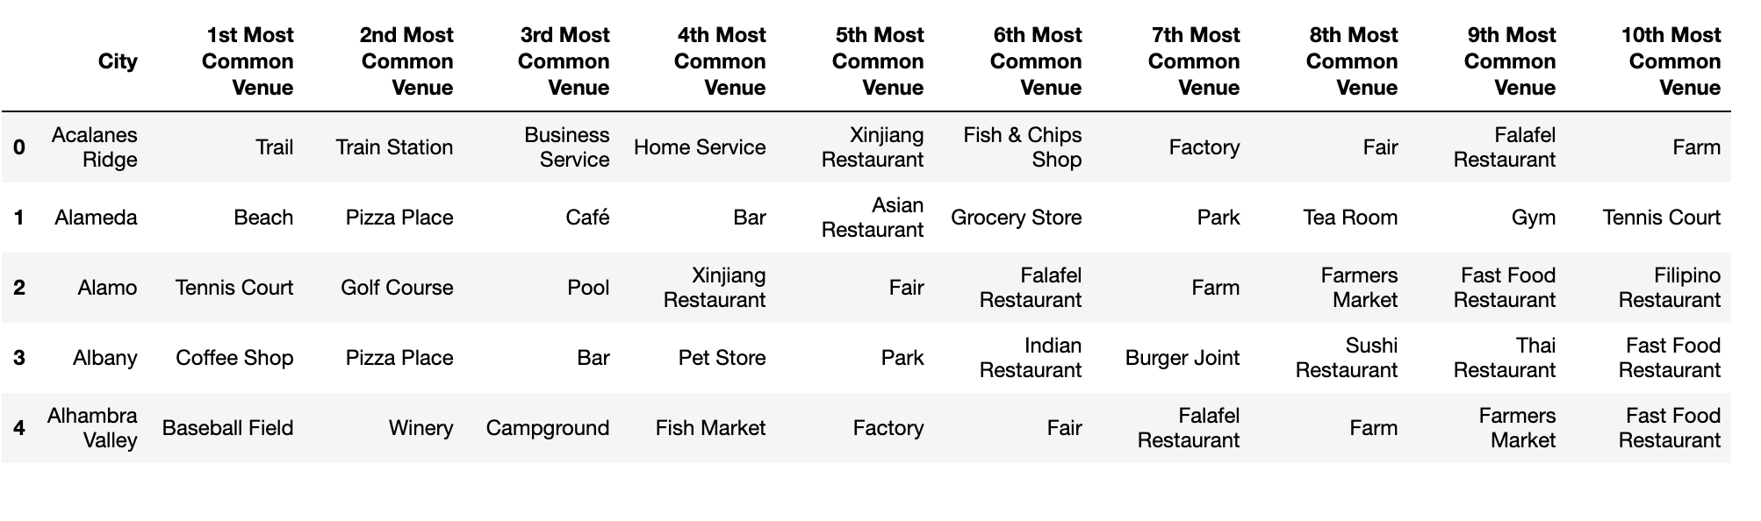
Foursquare API

Slide 8
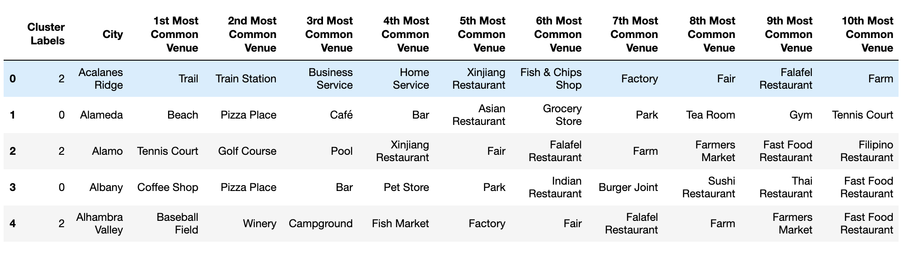
K-Means Cluster

Slide 9
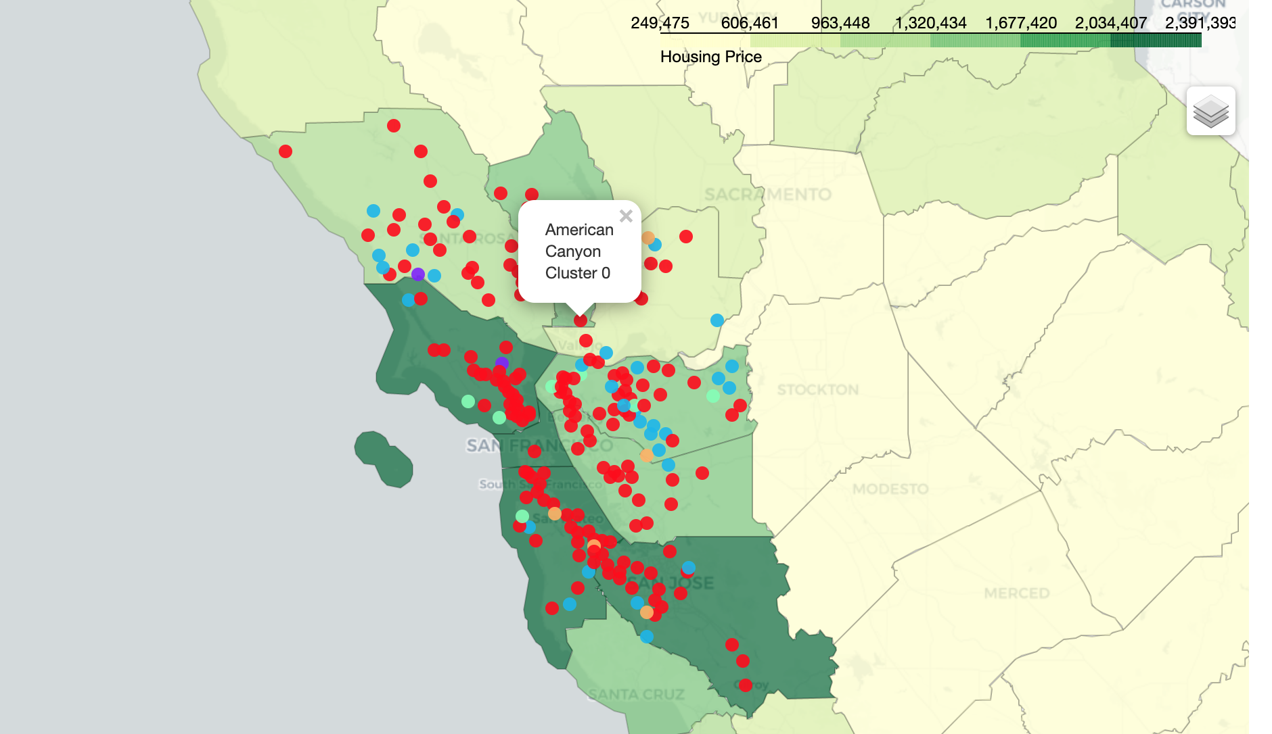
Visualise the clusters in the Folium map

Slide 10
Conclusion and Discussions
Build to identify the counties that has affordable house sales price
Data analysis is performed through datasets by adding the coordinates of counties and house sales price averages.
Helps stakeholders in narrowing down the search for optimal location for new housing projects

